Slide 1
2
Probability
CHAPTER OUTLINE
2-1 Sample Spaces & Events
2-1.1 Random Experiments
2-1.2 Sample Spaces
2-1.3 Events
2-1.4 Count Techniques
2-2 Interpretations & Axioms of Probability
2-3 Addition Rules
2-4 Conditional Probability
2-5 Multiplication & Total Probability Rules
2-6 Independence
2-7 Bayes’ Theorem
2-8 Random Variables

Slide 2
Learning Objectives for Chapter 2
After careful study of this chapter, you should be able to do the following:
Understand and describe sample spaces and events for random experiments with graphs, tables, lists, or tree diagrams.
Interpret probabilities and use probabilities of outcomes to calculate probabilities of events in discrete sample spaces.
Use permutation and combinations to count the number of outcomes in both an event and the sample space .
Calculate the probabilities of joint events such as unions and intersections from the probabilities of individuals events.
Interpret and calculate conditional probabilities of events.
Determine the independence of events and use independence to calculate probabilities.
Use Bayes’ theorem to calculate conditional probabilities .
Understand random variables.
© John Wiley & Sons, Inc. Applied Statistics and Probability for Engineers, by Montgomery and Runger.

Slide 3
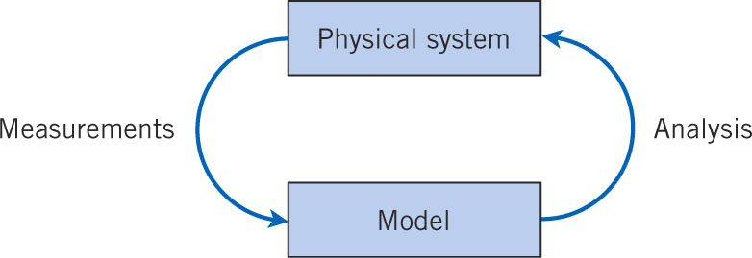
Random Experiments
The goal is to understand, quantify and model the variation affecting a physical system’s behavior. The model is used to analyze and predict the physical system’s behavior as system inputs affect system outputs. The predictions are verified through experimentation with the physical system.
Figure 2-1 Continuous iteration between model and physical system.

Slide 4
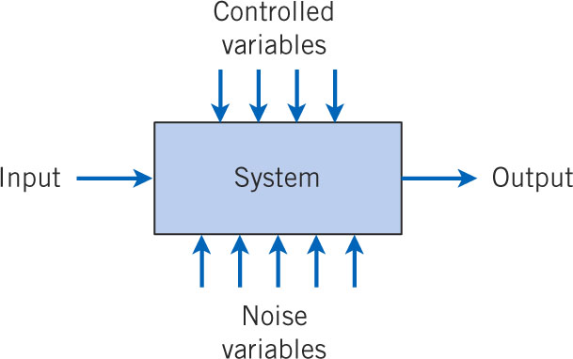
Noise Produces Output Variation
Random values of the noise variables cannot be controlled and cause the random variation in the output variables. Holding the controlled inputs constant does not keep the output values constant.
Figure 2-2 Noise variables affect the transformation of inputs to outputs.

Slide 5
Random Experiment
An experiment is an operation or procedure, carried out under controlled conditions, executed to discover an unknown result or to illustrate a known law.
An experiment that can result in different outcomes, even if repeated in the same manner every time, is called a random experiment.

Slide 6
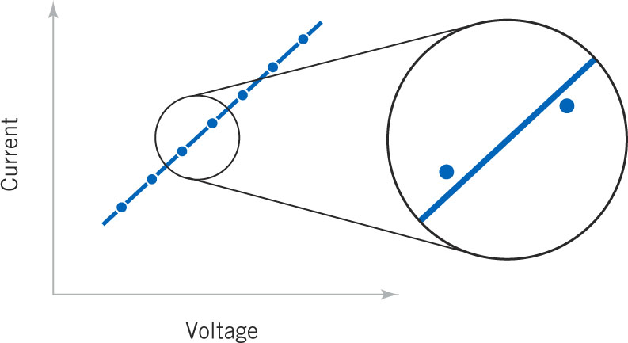
Randomness Affects Natural Law
Ohm’s Law current is a linear function of voltage. However, current will vary due to noise variables, even under constant voltage.
Figure 2-3 A closer examination of the system identifies deviations from the model.

Slide 7
Randomness Can Disrupt a System
Telephone systems must have sufficient capacity (lines) to handle a random number of callers at a random point in time whose calls are of a random duration.
If calls arrive exactly every 5 minutes and last for exactly 5 minutes, only 1 line is needed – a deterministic system.
Practically, times between calls are random and the call durations are random. Calls can come into conflict as shown in following slide.
Conclusion: Telephone system design must include provision for input variation.

Slide 8
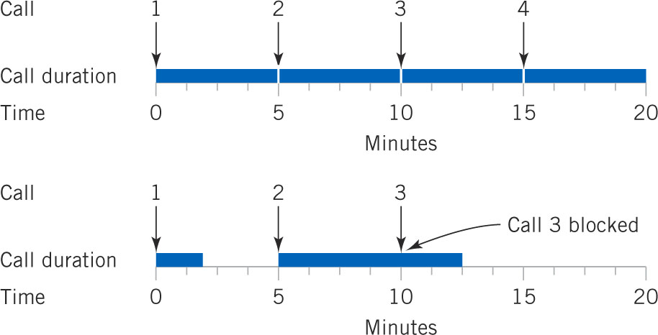
Deterministic & Random Call Behavior
Calls arrive every 5 minutes. In top system, call durations are all of 5 minutes exactly. In bottom system, calls are of random duration, averaging 5 minutes, which can cause blocked calls, a “busy” signal.
Figure 2-4 Variation causes disruption in the system.

Slide 9
Sample Spaces
Random experiments have unique outcomes.
The set of all possible outcome of a random experiment is called the sample space, S.
S is discrete if it consists of a finite or countable infinite set of outcomes.
S is continuous if it contains an interval (either a finite or infinite width) of real numbers.

Slide 10
Example 2-1: Defining Sample Spaces
Randomly select and measure the thickness of a part. S = R⁺ = {x|x > 0}, the positive real line. Negative or zero thickness is not possible. S is continuous.
It is known that the thickness is between 10 and 11 mm. S = {x|10 < x < 11}, continuous.
It is known that the thickness has only three values. S = {low, medium, high}, discrete.
Does the part thickness meet specifications? S = {yes, no}, discrete.

Slide 11
Example 2-2: Defining Sample Spaces, n=2
Two parts are randomly selected & measured. S = R⁺ * R⁺, S is continuous.
Do the 2 parts conform to specifications? S = {yy, yn, ny, nn}, S is discrete.
Number of conforming parts? S = {1, 1, 2}, S is discrete.
Parts are randomly selected until a non-conforming part is found. S = {n, yn, yyn, yyyn, …}, S is countably infinite.

Slide 12
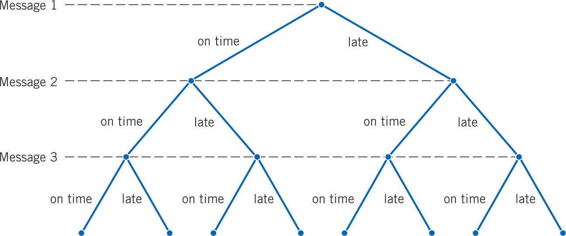
Sample Space Is Defined By A Tree Diagram
Example 2-3: Messages are classified as on-time or late. 3 messages are classified. There are 2³ = 8 outcomes in the sample space. S = {ooo, ool,olo, oll, loo, lol, llo, lll}
Figure 2-5 Tree diagram for three messages.

Slide 13
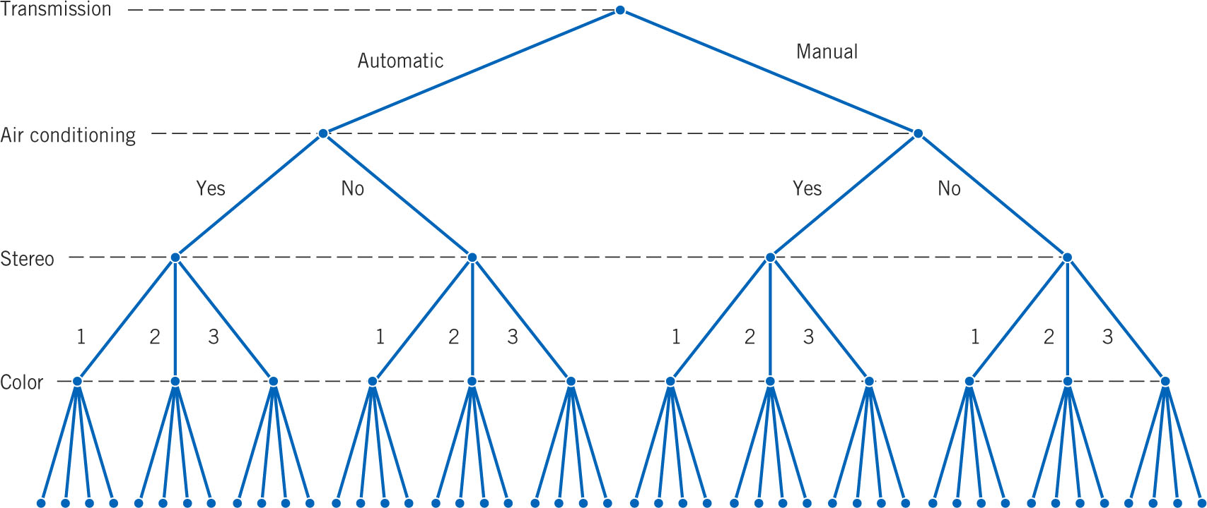
Tree Diagrams Can Fit The Situation
Example 2-4: New cars can be equipped with selected options as follows:
Manual or automatic transmission
With or without air conditioning
Three choices of stereo sound systems
Four exterior color choices
Figure 2-6 Tree diagram for different configurations of vehicles. Note that S has 2*2*3*4 = 48 outcomes.

Slide 14
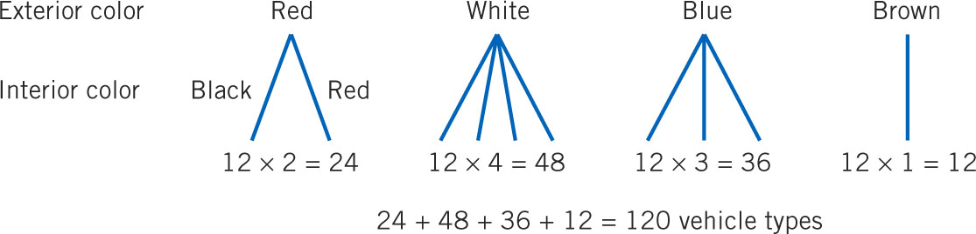
Tree Diagrams Help Count Outcomes
Example 2-5: The interior car color can depend on the exterior color as shown in the tree diagrams below. There are 12 possibilities without considering color combinations.
Figure 2-7 Tree diagram for different vehicle configurations with interior colors.

Slide 15
Events Are Sets of Outcomes
An event (E) is a subset of the sample space of a random experiment, i.e., one or more outcomes of the sample space.
Event combinations are:
Union of two events is the event consisting of all outcomes that are contained in either of two events, E₁  E₂. Called E₁ or E₂.
Intersection of two events is the event consisting of all outcomes that contained in both of two events, E₁  E₂. Called E₁ and E₂.
Complement of an event is the set of outcomes that are not contained in the event, E’ or not E.

Slide 16
Example 2-6, Discrete Event Algebra
Recall the sample space from Example 2-2, S = {yy, yn, ny, nn} concerning conformance to specifications.
Let E₁ denote the event that at least one part does conform to specifications, E₁ = {yy, yn, ny}
Let E₂ denote the event that no part conforms to specifications, E₂ = {nn}
Let E₃ = Ø, the null or empty set.
Let E₄ = S, the universal set.
Let E₅ = {yn, ny, nn}, at least one part does not conform.
Then E₁  E₅ = S
Then E₁  E₅ = {yn, ny}
Then E₁’ = {nn}

Slide 17
Example 2-7, Continuous Event Algebra
Measurements of the thickness of a part are modeled with the sample space: S = R⁺.
Let E₁ = {x|10 ≤ x < 12}, show on the real line below.
Let E₂ = {x|11 < x < 15}
Then E₁  E₂ = {x|10 ≤ x < 15}
Then E₁  E₂ = {x|11 < x < 12}
Then E₁’ = {x|x < 10 or x ≥ 12}
Then E₁’  E₂ = {x|12 ≥ x < 15}

Slide 18
Example 2-8, Hospital Emergency Visits
This table summarizes the ER visits at 4 hospitals. People may leave without being seen by a physician( LWBS). The remaining people are seen, and may or may not be admitted.
Let A be the event of a visit to Hospital 1.
Let B be the event that the visit is LWBS.
Find number of outcomes in:
A  B
A’
A  B
Notes:
Double right click on the Excel object. Show how Excel calculated the answers.

Slide 19
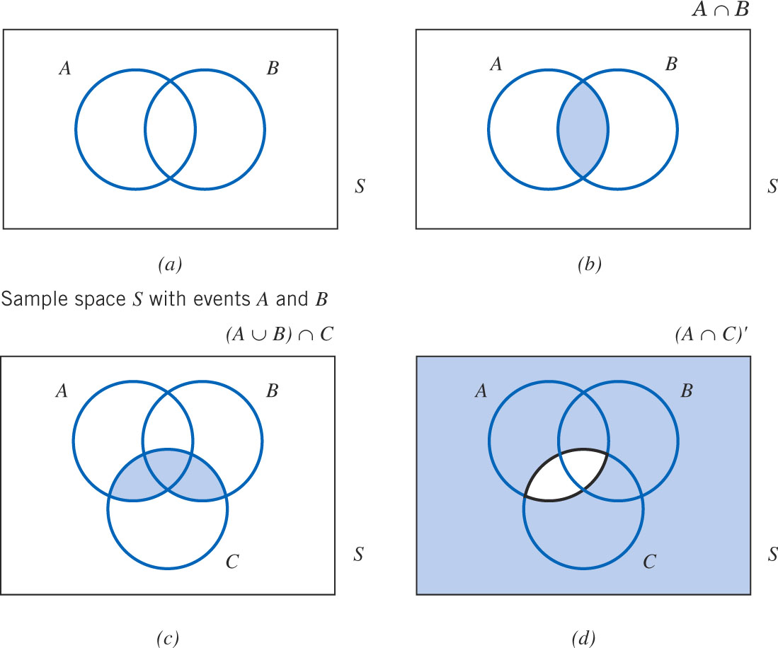
Venn Diagrams Show Event Relations
Events A & B contain their respective outcomes. The shaded regions indicate the event relation of each diagram.
Figure 2-8 Venn diagrams

Slide 20
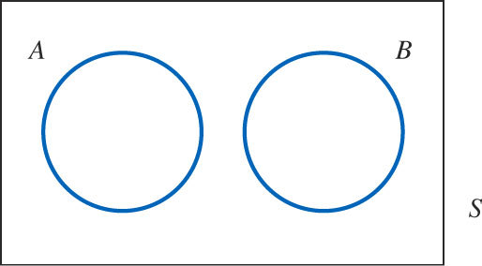
Venn Diagram of Mutually Exclusive Events
Events A & B are mutually exclusive because they share no common outcomes.
The occurrence of one event precludes the occurrence of the other.
Symbolically, A  B = Ø
Figure 2-9 Mutually exclusive events

Slide 21
Event Relation Laws
Transitive law (event order is unimportant):
A  B = B  A and A  B = B  A
Distributive law (like in algebra):
(A  B)  C = (A  C)  (B  C)
(A  B)  C = (A  C)  (B  C)
DeMorgan’s laws:
(A  B)’ = A’  B’ The complement of the union is the intersection of the complements.
(A  B)’ = A’  B’ The complement of the intersection is the union of the complements.

Slide 22
Counting Techniques
These are three special rules, or counting techniques, used to determine the number of outcomes in the events and the sample space.
They are the:
Multiplication rule
Permutation rule
Combination rule
Each has its special purpose that must be applied properly – the right tool for the right job.

Slide 23
Counting – Multiplication Rule
Multiplication rule:
Let an operation consist of k steps and
n₁ ways of completing step 1,
n₂ ways of completing step 2, … and
n_{k} ways of completing step k.
Then, the total number of ways or outcomes are:
n₁ * n₂*…*n_{k}

Slide 24
Example 2-9: Multiplication Rule
In the design for a gear housing, we can choose to use among:
4 different fasteners,
3 different bolt lengths and
2 different bolt locations.
How many designs are possible?
Answer: 4 * 3 * 2 = 24

Slide 25
Counting – Permutation Rule
A permutation is a unique sequence of distinct items.
If S = {a, b, c}, then there are 6 permutations
Namely: abc, acb, bac, bca, cab, cba (order matters)
The # of ways 3 people can be arranged.
# of permutations for a set of n items is n!
n! (factorial function) = n*(n-1)*(n-2)*…*2*1
7! = 7*6*5*4*3*2*1 = 5,040 = FACT(7) in Excel
By definition: 0! = 1

Slide 26
Counting – Sub-set Permutations
To sequence only r items from a set of n items:

Slide 27
Example 2-10: Circuit Board Designs
A printed circuit board has eight different locations in which a component can be placed. If four different components are to be placed on the board , how many designs are possible?
Answer: order is important, so use the permutation formula with n = 8, r = 4.

Slide 28
Counting - Similar Item Permutations
Used for counting the sequences when not all the items are different.
The number of permutations of:
n = n₁ + n₂ + … + n_{r} items of which
n₁ are identical,
n₂ are identical, … , and
n_{r} are identical.
Is calculated as:

Slide 29
Example 2-11: Machine Shop Schedule
In a machining operation, a piece of sheet metal needs two identical-diameter holes drilled and two identical-size notched cut. The drilling operation is denoted as d and the notching as n.
How many sequences are there?
What is the set of sequences?
{ddnn, dndn, dnnd, nddn, ndnd, nndd}

Slide 30
Example 2-12: Bar Codes
A part is labeled with 4 thick lines, 3 medium lines, and two thin lines. Each sequence is a different label.
How many unique labels can be created?
In Excel:

Slide 31
Counting – Combination Rule
A combination is a selection of r items from a set of n where order does not matter.
If S = {a, b, c}, n =3, then there is 1 combination.
If r =3, there is 1 combination, namely: abc
If r=2, there are 3 combinations, namely ab, ac, bc
# of permutations ≥ # of combinations

Slide 32
Example 2-13: Applying the Combination Rule
A circuit board has eight locations in which a component can be placed. If 5 identical components are to be placed on a board, how many different designs are possible?
The order of the components is not important, so the combination rule is appropriate.
Excel:

Slide 33
Example 2-14: Sampling w/o Replacement-1
A bin of 50 parts contains 3 defectives & 47 good parts. A sample of 6 parts is selected from the 50 without replacement.
How many different samples of size 6 are there that contain exactly 2 defective parts?
In Excel:

Slide 34
Example 2-14: Sampling w/o Replacement-2
Now, how many ways are there of selecting 4 parts from the 47 acceptable parts?
In Excel:

Slide 35
Example 2-14: Sampling w/o Replacement-3
Now, how many ways are there to obtain:
2 from the 3 defectives, and
4 from the 47 non-defectives?
In Excel:

Slide 36
Example 2-14: Sampling w/o Replacement-4
Furthermore, how many ways are there to obtain 6 parts (0-6 defectives) from the set of 50?
So the ratio of obtaining 2 defectives out 6 to any number (0-6) defectives out of 6 is:

Slide 37
What Is Probability?
Probability is the likelihood or chance that a particular outcome or event from a random experiment will occur.
Here, only finite sample spaces ideas apply.
Probability is a number in the [0,1] interval.
May be expressed as a:
proportion (0.15)
percent (15%)
fraction (3/20)
A probability of:
1 means certainty
0 means impossibility

Slide 38
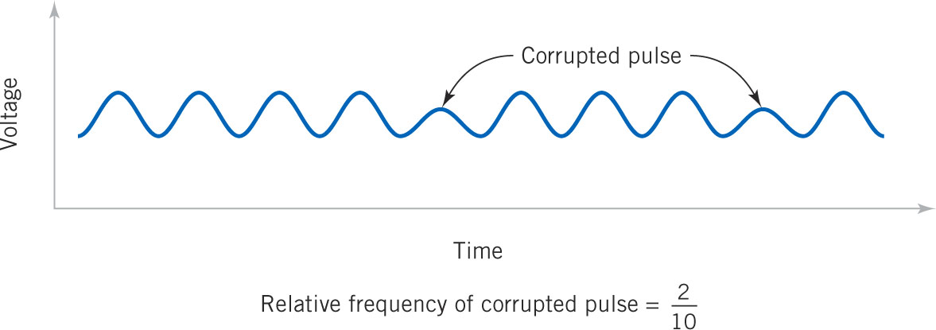
Types of Probability
Subjective probability is a “degree of belief.”
“There is a 50% chance that I’ll study tonight.”
Relative frequency probability is based how often an event occurs over a very large sample space.
Figure 2-10 Relative frequency of corrupted pulses over a communications channel

Slide 39
Probability Based on Equally-Likely Outcomes
Whenever a sample space consists of N possible outcomes that are equally likely, the probability of each outcome is 1/N.
Example: In a batch of 100 diodes, 1 is colored red. A diode is randomly selected from the batch. Random means each diode has an equal chance of being selected. The probability of choosing the red diode is 1/100 or 0.01, because each outcome in the sample space is equally likely.

Slide 40
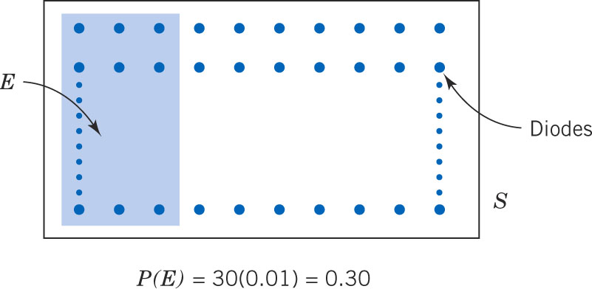
Example 2-15: Laser Diodes
Assume that 30% of the laser diodes in a batch of 100 meet a customer requirements.
A diode is selected randomly. Each diode has an equal chance of being selected. The probability of selecting an acceptable diode is 0.30.
Figure 2-11 Probability of the event E is the sum of the probabilities of the outcomes in E.

Slide 41
Probability of an Event
For a discrete sample space, the probability of an event E, denoted by P(E), equals the sum of the probabilities of the outcomes in E.
The discrete sample space may be:
A finite set of outcomes
A countably infinite set of outcomes.
Further explanation is necessary to describe probability with respect to continuous sample spaces.

Slide 42
Example 2-16: Probabilities of Events
A random experiment has a sample space {w,x,y,z}. These outcomes are not equally-likely; their probabilities are: 0.1, 0.3, 0.5, 0.1.
Event A ={w,x}, event B = {x,y,z}, event C = {z}
P(A) = 0.1 + 0.3 = 0.4
P(B) = 0.3 + 0.5 + 0.1 = 0.9
P(C) = 0.1
P(A’) = 0.6 and P(B’) = 0.1 and P(C’) = 0.9
Since event AB = {x}, then P(AB) = 0.3
Since event AB = {w,x,y,z}, then P(AB) = 1.0
Since event AC = {null}, then P(AC ) = 0.0

Slide 43
Example 2-17: Contamination Particles
An inspection of a large number of semiconductor wafers revealed the data for this table. A wafer is selected randomly.
Let E be the event of selecting a 0 particle wafer. P(E) = 0.40
Let E be the event of selecting a wafer with 3 or more particles. P(E) = 0.10+0.05+0.10 = 0.25

Slide 44
Example 2-18: Sampling w/o Replacement
A batch of parts contains 6 parts {a,b,c,d,e,f}. Two are selected at random. Suppose part f is defective. What is the probability that part f appears in the sample?
How many possible samples can be drawn?
Excel:
How many samples contain part f?
5 by enumeration: {af,bf,cf,df,ef}
P(defective part) = 5/15 = 1/3.

Slide 45
Axioms of Probability
Probability is a number that is assigned to each member of a collection of events from a random experiment that satisfies the following properties:
P(S) = 1
0 ≤ P(E) ≤ 1
For each two events E₁ and E₂ with E₁E₂ = Ø, P(E₁E₂) = P(E₁) + P(E₂)
These imply that:
P(Ø) =0 and P(E’) = 1 – P(E)
If E₁ is contained in E₂, then P(E₁) ≤ P(E₂).

Slide 46
Addition Rules
Joint events are generated by applying basic set operations to individual events, specifically:
Unions of events, A  B
Intersections of events, A  B
Complements of events, A’
Probabilities of joint events can often be determined from the probabilities of the individual events that comprise it. And conversely.

Slide 47
Example 2-19: Semiconductor Wafers
A wafer is randomly selected from a batch as shown in the table.
Let H be the event of high concentrations of contaminants. Then P(H) = 358/940.
Let C be the event of the wafer being located at the center of a sputtering tool used in manufacture. Then P(C) = 626/940.
P(HC) = 112/940
P(HC) = P(H) + P(C) - P(HC) = (358+626-112)/940 This is the addition rule.

Slide 48
The probability of a union:
If events A and B are mutually exclusive:

Slide 49
Example 2-20: Contaminants & Location
Wafers in last example are now classified by degree of contamination per table of proportions.
E₁ is the event that a wafer has 4 or more particles. P(E₁) = 0.15
E₂ is the event that a wafer was on edge. P(E₂) = 0.28
P(E₁E₂) = 0.04
P(E₁E₂)
=0.15 + 0.28 – 0.04
= 0.39

Slide 50
Addition Rule: 3 or More Events
(2-7)
Note the alternating signs.
(2-8)

Slide 51
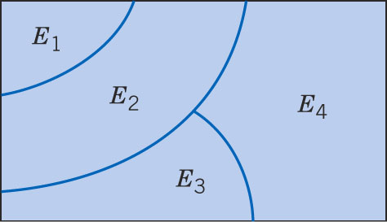
Venn Diagram of Mutually Exclusive Events
Figure 2-12 Venn diagram of four mutually exclusive events. Note that no outcomes are common to more than one event, i.e. all intersections are null.

Slide 52
Example 2-21: pH
Let X denote the pH of a sample. Consider the event that P(6.5 < X ≤ 7.5) =
P(6.5 < X ≤ 7.0) + P(7.0 < X ≤ 7.5) + P(7.5 < X ≤ 7.8)
The partition of an event into mutually exclusive subsets is widely used to allocate probabilities.

Slide 53
Conditional Probability
Probabilities should be reevaluated as additional information becomes available.
P(B|A) is called the probability of event B occurring, given that event A has already occurred.
A communications channel has an error rate of 1 per 1000 bits transmitted. Errors are rare, but do tend to occur in bursts. If a bit is in error, the probability that the next bit is also an error ought to be greater than 1/1000.

Slide 54
An Example of Conditional Probability
In a thin film manufacturing process, the proportion of parts that are not acceptable is 2%. However the process is sensitive to contamination that can increase the rate of parts rejection.
If we know that the plant is having filtration problems that increase film contamination, we would presume that the rejection rate has increased.

Slide 55
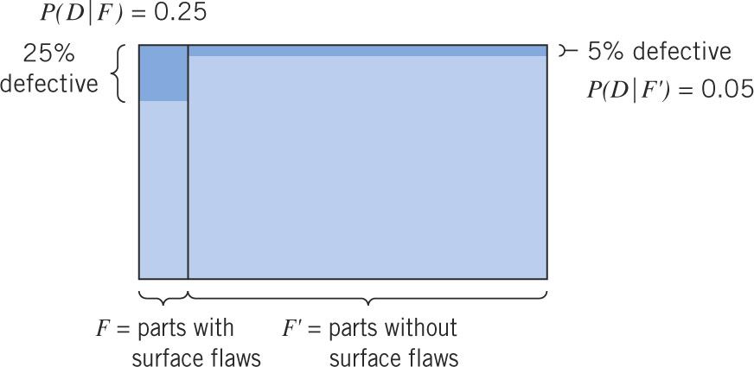
Another Example of Conditional Probability
Figure 2-13 Conditional probability of rejection for parts with surface flaws and for parts without surface flaws. The probability of a defective part is not evenly distributed. Flawed parts are five times more likely to be defective than non-flawed parts, i.e., P(D|F) / P(D|F’).

Slide 56
Example 2-22: A Sample From Prior Graphic
Table 2-3 shows that 400 parts are classified by surface flaws and as functionally defective. Observe that:
P(D|F) = 10/40 = 0.25
P(D|F’) = 18/360 = 0.05

Slide 57
Conditional Probability Rule
The conditional probability of event B given event A, denoted as P(A|B), is:
P(B|A) = P(AB) / P(A) (2-9)
for P(A) > 0.
From a relative frequency perspective of n equally likely outcomes:
P(A) = (number of outcomes in A) / n
P(AB) = (number of outcomes in AB) / n

Slide 58
Example 2-23: More Surface Flaws
Refer to Table 2-3 again. There are 4 probabilities conditioned on flaws.

Slide 59
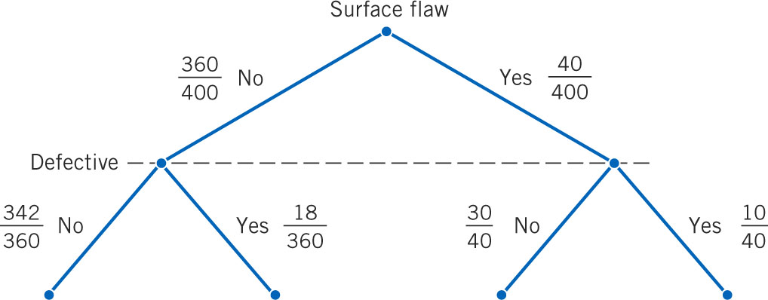
Example 2-23: Tree Diagram
Tree illustrates sampling two parts without replacement:
At the 1st stage (flaw), every original part of the 400 is equally likely.
At the 2nd stage (defect), the probability is conditional upon the part drawn in the prior stage.
Figure 2-14 Tree diagram for parts classification

Slide 60
Random Samples & Conditional Probabilities
Random means each item is equally likely to be chosen. If more than one item is sampled, random means that every sampling outcome is equally likely.
2 items are taken from S = {a,b,c} without replacement.
Ordered sample space: S = {ab,ac,bc,ba,bc,cb}
Unordered sample space: S = {ab,ac,bc}
This is done by enumeration – too hard ☹

Slide 61
Sampling Without Enumeration
Use conditional probability to avoid enumeration. To illustrate: A batch of 50 parts contains 10 made by Tool 1 and 40 made by Tool 2. We take a sample of n=2.
What is the probability that the 2nd part came from Tool 2, given that the 1st part came from Tool 1?
P(1st part came from Tool 1) = 10/50
P(2nd part came from Tool 2) = 40/49
P(Tool 1, then Tool 2 part sequence) = (10/50)*(40/49)
To select randomly implies that, at each step of the sample, the items remaining in the batch are equally likely to be selected.

Slide 62
Example 2-24: Sampling Without Replacement
A production lot of 850 parts contains 50 defectives. Two parts are selected at random.
What is the probability that the 2nd is defective, given that the first part is defective?
Let A denote the event that the 1st part selected is defective.
Let B denote the event that the 2nd part selected is defective.
Probability desired is P(B|A) = 49/849.

Slide 63
Example 2-25: Continuing Prior Example
Now, 3 parts are sampled randomly.
What is the probability that the first two are defective, while the third is not?
In Excel:

Slide 64
Multiplication Rule
The conditional probability definition of Equation 2-9 can be rewritten to generalize it as the multiplication rule.
P(AB) = P(B|A)*P(A) = P(A|B)*P(B) (2-10)
The last expression is obtained by exchanging the roles of A and B.

Slide 65
Example 2-26: Machining Stages
The probability that, a part made in the 1st stage of a machining operation passes inspection, is 0.90. The probability that, it passes inspection after the 2nd stage, is 0.95.
What is the probability that the part meets specifications?
Let A & B denote the events that the 1st & 2nd stages meet specs.
P(AB) = P(B|A)*P(A) = 0.95*0.90 = 0.955

Slide 66
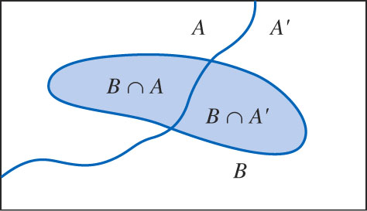
Two Mutually Exclusive Subsets
A & A’ are mutually exclusive.
AB and A’B are mutually exclusive
B = (AB)  (AB)
Figure 2-15 Partitioning an event into two mutually exclusive subsets.

Slide 67
Total Probability Rule
For any two events A and B:

Slide 68
Example 2-27: Semiconductor Contamination
Information about product failure based on chip manufacturing process contamination.
F denotes the event that the product fails.
H denotes the event that the chip is exposed to high contamination during manufacture.
P(F|H) = 0.100 & P(H) = 0.2, so P(FH) = 0.02
P(F|H’) = 0.005 and P(H’) = 0.8, so P(F H’) = 0.004
P(F) = P(FH) + P(F H’) = 0.020 + 0.004 = 0.024

Slide 69
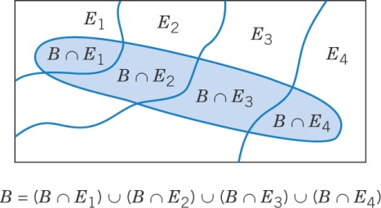
Total Probability Rule (multiple events)
Assume E₁, E₂, … E_{k} are k mutually exclusive & exhaustive subsets. Then:
Figure 2-16 Partitioning an event into several mutually exclusive subsets.

Slide 70
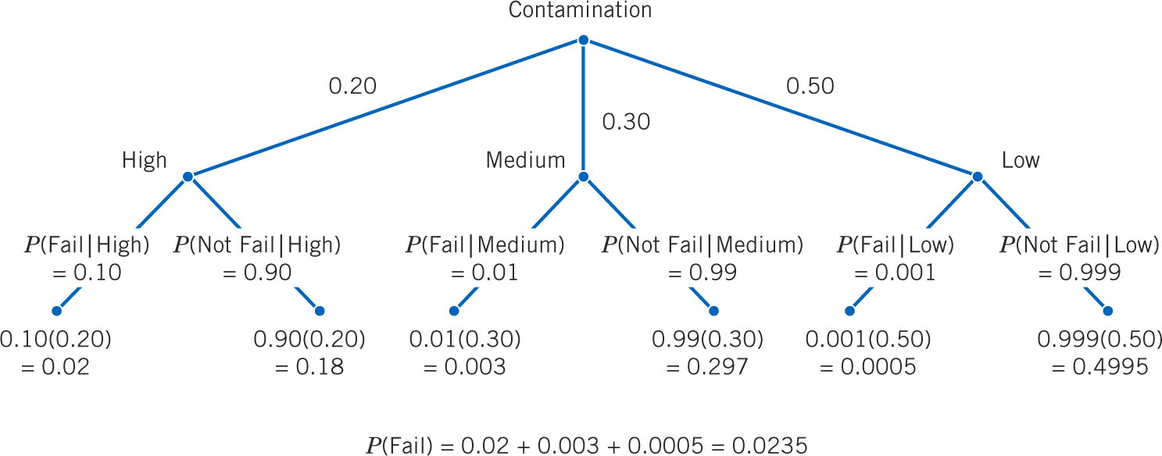
Example 2-28: Refined Contamination Data
Continuing the discussion of contamination during chip manufacture:
Figure 2-17 Tree diagram

Slide 71
Event Independence
Two events are independent if any one of the following equivalent statements are true:
P(B|A) = P(A)
P(A|B) = P(B)
P(AB) = P(A)*P(B)
This means that occurrence of one event has no impact on the occurrence of the other event.

Slide 72
Example 2-29: Sampling With Replacement
A production lot of 850 parts contains 50 defectives. Two parts are selected at random, but the first is replaced before selecting the 2nd.
Let A denote the event that the 1st part selected is defective. P(A) = 50/850
Let B denote the event that the 2nd part selected is defective. P(B) = 50/850
What is the probability that the 2nd is defective, given that the first part is defective? The same.
Probability that both are defective is: P(A)*P(B) = 50/850 *50/850 = 0.0035.

Slide 73
Example 2-30: Flaw & Functions
The data shows whether the events are independent.

Slide 74
Example 2.31: Conditioned vs. Unconditioned
A production lot of 850 parts contains 50 defectives. Two parts are selected at random, without replacement.
Let A denote the event that the 1st part selected is defective. P(A) = 50/850
Let B denote the event that the 2nd part selected is defective. P(B|A) = 49/849
Probability that the 2nd is defective is: P(B) = P(B|A)*P(A) + P(B|A’)*P(A’)
P(B) = (49/849) *(50/850) + (50/849)*(800/850)
P(B) = (49*50+50*800) / (849*850)
P(B) = 50*(49+800) / (849*850)
P(B) = 50/850 is unconditional, same as P(A)
Since P(B|A) ≠ P(A), then A and B are dependent.

Slide 75
Independence with Multiple Events
The events E₁, E₂, … , E_{k} are independent if and only if, for any subset of these events:
P(E₁E₂  … , E_{k}) = P(E₁)* P(E₂)*…* P(E_{k}) (2-14)
Be aware that, if E₁ & E₂ are independent, E₂ & E₃ may or may not be independent.

Slide 76

Example 2-32: Series Circuit
This circuit operates only if there is a path of functional devices from left to right. The probability that each device functions is shown on the graph. Assume that the devices fail independently. What is the probability that the circuit operates?
Let L & R denote the events that the left and right devices operate. The probability that the circuit operates is:
P(LR) = P(L) * P(R) = 0.8 * 0.9 = 0.72.

Slide 77
Example 2-33: Another Series Circuit
The probability that a wafer contains a large particle of contamination is 0.01. The wafer events are independent.
P(E_{i}) denotes the event that the i^{th} wafer contain no particles and P(E_{i}) = 0.99.
If 15 wafers are analyzed, what is the probability that no large particles are found?
P(E₁E₂ … E_{k}) = P(E₁)*P(E₂)*…*P(E_{k}) = (0.99)¹⁵ = 0.86.

Slide 78
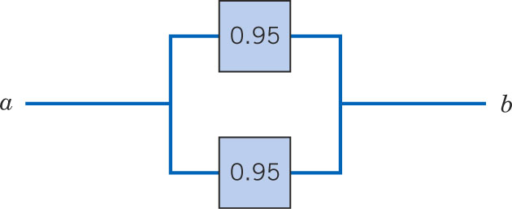
Example 2-34: Parallel Circuit
This circuit operates only if there is a path of functional devices from left to right. The probability that each device functions is shown. Each device fails independently.
Let T & B denote the events that the top and bottom devices operate. The probability that the circuit operates is:
P(TB) = 1 - P(T’  B’) = 1- P(T’)*P(B’) = 1 – 0.05² = 1 – 0.0025 – 0.9975.
( this is 1 minus the probability that they both don’t fail)

Slide 79
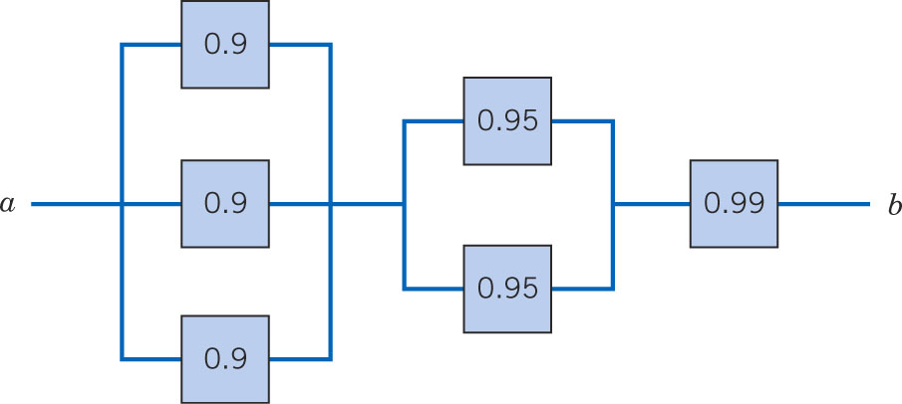
Example 2-35: Advanced Circuit
This circuit operates only if there is a path of functional devices from left to right. The probability that each device functions is shown. Each device fails independently.
Partition the graph into 3 columns with L & M denoting the left & middle columns.
P(L) = 1- 0.1³ , and P(M) = 1- 0.5², so the probability that the circuit operates is: (1 – 0.1³)(1-0.05²)(0.99) = 0.9875 ( this is a series of parallel circuits). In Excel:

Slide 80
Bayes Theorem
Thomas Bayes (1702-1761) was an English mathematician and Presbyterian minister.
His idea is that we observe conditional probabilities through prior information.
The short formal statement is:
Note the reversal of the condition!
(2-15)

Slide 81
Example 2-36:
From Example 2-27, find P(F) which is not given:

Slide 82
Bayes Theorem with Total Probability
If E₁, E₂, … E_{k} are k mutually exclusive and exhaustive events and B is any event,
for P(B) > 0 (2-16)
Note that the:
Total probability expression of the denominator
Numerator is always one term of the denominator.

Slide 83
Example 2-37: Medical Diagnostic-1
Because a new medical procedure has been shown to be effective in the early detection of a disease, a medical screening of the population is proposed. The probability that the test correctly identifies someone with the disease as positive is 0.99, and probability that the test correctly identifies someone without the disease as negative is 0.95. The incidence of the illness in the general population is 0.0001. You take the test and the result is positive. What is the probability that you have the illness?
Let D denote the event that you have the disease and let S denote the event that the test signals positive. Given info is:
P(S’|D’) = 0.95, so P(S|D’) = 0.05, and P(D) = 0.0001,
P(S|D) = 0.99. We desire P(D|S).

Slide 84
Example 2-37: Medical Diagnostic-2
Excel:
Before the test, your chance was 0.0001. After the positive result, your chance is 0.00198. So your risk of having the disease has increased 20 times = 0.00198/0.00010, but is still tiny.

Slide 85
Example 2-38: Bayesian Network-1
Bayesian networks are used on Web sites of high-tech manufacturers to allow customers to quickly diagnose problems with products. A printer manufacturer obtained the following probabilities from its database. Printer failures are of 3 types: hardware P(H) = 0.3, software P(S)=0.6, and other P(O)=0.1. Also:
P(F|H) = 0.9, P(F|S) = 0.2, P(F|O) = 0.5.
Find the max of P(H|F), P(S|F), P(O|F) to direct the diagnostic effort.

Slide 86
Example 2-38: Bayesian Network-2
Note that the conditionals based on Failure add to 1. Since the Other category is the most likely cause of the failure, diagnostic effort should be so initially directed.

Slide 87
Random Variables
A variable that associates a number with the outcome of a random experiment is called a random variable.
A random variable is a function that assigns a real number to each outcome in the sample space of a random experiment.
Particular notation is used to distinguish the random variable (rv) from the real number. The rv is denoted by an uppercase letter, such as X. After the experiment is conducted, the measured value is denoted by a lowercase letter, such a x = 70. X and x are shown in italics, e.g., P(X=x).

Slide 88
Continuous & Discrete Random Variables
A discrete random variable is a rv with a finite (or countably infinite) range. They are usually integer counts, e.g., number of errors or number of bit errors per 100,000 transmitted (rate). The ends of the range of rv values may be finite (0 ≤ x ≤ 5) or infinite (x ≥ 0).
A continuous random variable is a rv with an interval (either finite or infinite) of real numbers for its range. Its precision depends on the measuring instrument.

Slide 89
Examples of Discrete & Continuous RVs
Discrete rv’s:
Number of scratches on a surface.
Proportion of defective parts among 100 tested.
Number of transmitted bits received in error.
Number of common stock shares traded per day.
Continuous rv’s:
Electrical current and voltage.
Physical measurements, e.g., length, weight, time, temperature, pressure.

Slide 90
Important Terms & Concepts of Chapter 2
Addition rule
Axioms of probability
Bayes’ theorem
Combination
Conditional probability
Equally likely outcomes
Event
Independence
Multiplication rule
Mutually exclusive events
Outcome
Permutation
Probability
Random experiment
Random variable
Discrete
Continuous
Sample space
Discrete
Continuous
Total probability rule
Tree diagram
Venn diagram
With replacement
Without replacement

